Slide 1
Project Name
Prediction of Heart Disease
Student Name: K Madhu Lavanya
Student ID: @01442868
Subject Name: Machine Learning Data Science
Semester: Fall 2023

Slide 2
Introduction
Applying ML enables data-driven decision making - By building an accurate predictive model, organizations can make better-informed, evidence-based decisions guided by data.
ML unlocks enhanced strategy development
ML drives optimized outcomes
Notes:
By building an accurate predictive model, organizations can make better-informed, evidence-based decisions guided by data. The patterns identified by ML provide the insight needed to improve strategies around operations, investments, resource allocation, and more. An ML model that reliably predicts outcomes helps organizations deploy interventions, allocate resources, and plan operations to optimize desired results.

Slide 3

Background
Compare predictive accuracy of ML algorithms
Identify key health predictors
Inform clinical screening processes
(Source:www.foreseemed.com)
Notes:
Testing different models side-by-side allows assessment of the algorithms' respective predictive capabilities on this real-world medical data. The patterns recognized by the best-performing models highlight which health attributes are most indicative of heart disease risk. The ML models can be translated into clinical decision support systems to augment diagnostic screening and early disease prevention.

Slide 4
Dataset Description
Ideal Inputs capture a wide range of relevant risk factors
Labeled Outcome of the project
Notes:
The inputs capture a wide range of relevant risk factors from demographics to different medical test results that reflect key health indicators. The presence or absence of heart disease for each patient provides the labeled ground truth target required for supervised training of ML models.

Slide 5
Model’s Baseline
Decision Tree captures feature interactions
Naive Bayes fast training and prediction
Logistic Regression estimates predictive probabilities
KNN conceptually simple, interpretable
Notes:
Decision Trees captures feature interactions, easily interpretable, handles nonlinearity well.
Naive Bayes fast training and prediction, works well with high dimensionality, performs surprisingly effectively despite simplifying assumptions. Logistic Regression estimates predictive probabilities, handles nonlinearity via transformations, interprets impact directionality and magnitude. KNN conceptually simple, interpretable, flexible similarity calculations, effective when sufficient labeled data available.

Slide 6
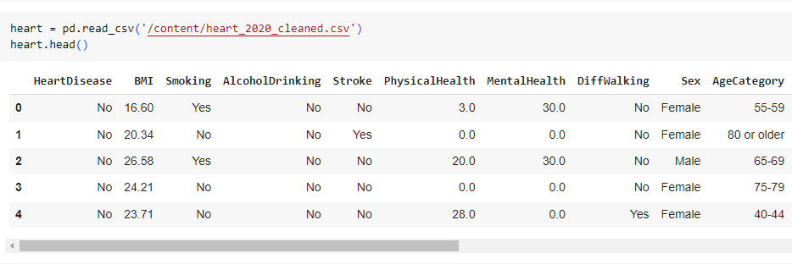

Building machine learning model
Load libraries Pandas and NumPy
Input dataset and read the CSV data
Explore or summarizing data
Split data into train and test
(Source: self created in google colab
Notes:
Pandas and NumPy imported for data manipulation and math. Fundamental for ML modeling. Read the CSV data into a pandas DataFrame for processing and analysis in Python. Use DataFrame methods like .shape, .info(), and .head() to inspect structure, datatypes, statistics of the input features and labels. Leverage train_test_split to create randomized stratified splits for training and evaluating model performance more robustly.

Slide 7
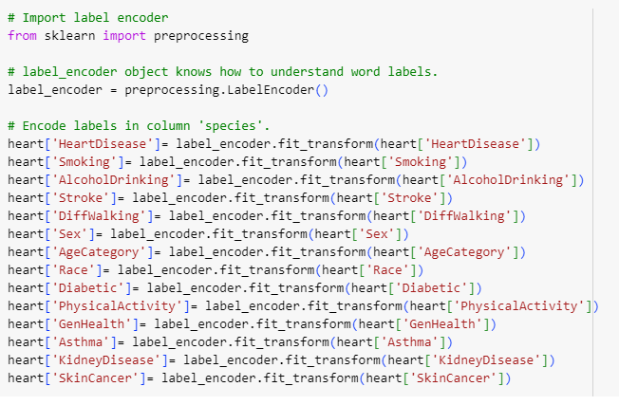
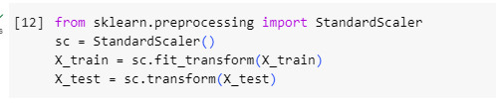
Building machine learning model
Encoding the labels in the dataset
Standardizing the features
Fitting the model
Predict outcomes accordingly
(Source code)
(Source code )
Notes:
Apply label encoding to convert categorical target variable to numeric values for modeling. Use StandardScaler to normalize input features to similar scales, preventing range discrepancies from harming model. Instantiate and train a Decision Tree classifier on normalized training data using cross-validation. Apply fitted model to unseen normalized test data to predict heart disease presence labels.

Slide 8
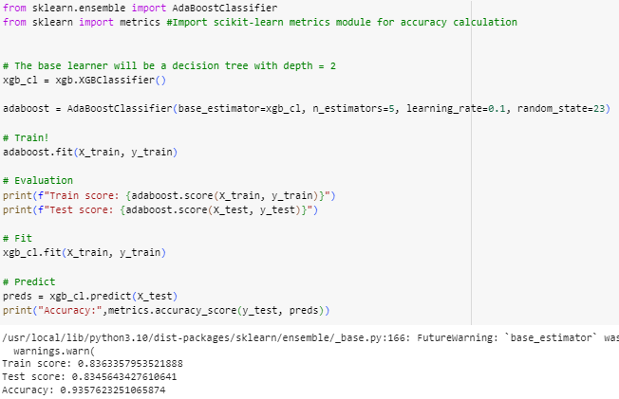
Comparing predicted and actual value for decision tree
Measuring the overall accuracy
Evaluating Per Class
(Source: self created in google colab )
Notes:
Overall accuracy score provides top-line view of how often predictions matched true labels. Gauges general effectiveness. Classification report drills into precision, recall and f1-score per class accounting for imbalances. Highlights subtle gaps.

Slide 9
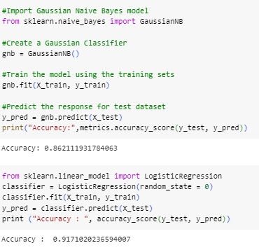
Comparing predicted and actual value for Naive Bayes
The overall accuracy is measured
Per Class is evaluated
(Source: self created in google colab )
Notes:
The Overall accuracy score gives a top-line view of how often predictions matched true labels. Gauges general effectiveness. Classification report drills into precision, recall and f1-score per class accounting for imbalances. Highlights subtle gaps.

Slide 10
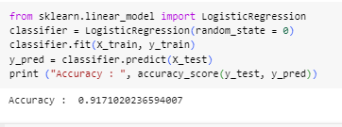
Comparing predicted and actual value for Logistic Regression
Overall accuracy concisely measures predictive capability but lacks nuance.
Classification report quantifies
Iterative refinement has been done
(Source: self created in google colab )
Notes:
Accuracy concisely measures predictive capability but lacks nuance. Precision, recall and f1 traces performance per class, accounting for skewed distributions. Dimensions where the model struggles guides focused effort to boost predictive power.

Slide 11
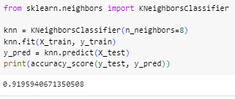
Comparing predicted and actual value for KNN
Accuracy provides overview - Overall accuracy concisely summarizes predictive power, but lacks depth.
Per-class metrics highlight gaps
Refinement requires diagnosis
(Source: self created in google colab )
Notes:
Overall accuracy concisely summarizes predictive power, but lacks depth. Precision, recall, f1-score per outcome quantifies performance differences. By identifying where and for which groups the model struggles, targeted improvements possible.

Slide 12
Conclusion
ML algorithms can produce accurate predictive models
Comparing multiple models side-by-side
Precision medicine could be enhanced by integrating clinical decision support systems
Continuous evaluation on dimensions
Notes:
Machine Learning algorithms can produce accurate predictive models for disease risk using clinical inputs like demographics, vital signs, and test results. It builds understanding of optimal techniques for different medical prediction problems. Precision medicine leveraging ML to risk stratify patients based on their holistic health profile. Evaluation continuation like per-class performance, confusion matrices, and more provides a multidimensional perspective to drive iterative model improvements.

Slide 13
Reference List
Journals
Alotaibi, F.S., 2019. Implementation of machine learning model to predict heart failure disease. International Journal of Advanced Computer Science and Applications, 10(6).
Neupane, D. and Seok, J., 2020. Bearing fault detection and diagnosis using case western reserve university dataset with deep learning approaches: A review. IEEE Access, 8, pp.93155-93178.
Kavitha, M., Gnaneswar, G., Dinesh, R., Sai, Y.R. and Suraj, R.S., 2021, January. Heart disease prediction using hybrid machine learning model. In 2021 6th international conference on inventive computation technologies (ICICT) (pp. 1329-1333). IEEE.
Naz, H. and Ahuja, S., 2020. Deep learning approach for diabetes prediction using PIMA Indian dataset. Journal of Diabetes & Metabolic Disorders, 19, pp.391-403.
Karatas, G., Demir, O. and Sahingoz, O.K., 2020. Increasing the performance of machine learning-based IDSs on an imbalanced and up-to-date dataset. IEEE access, 8, pp.32150-32162.
Faker, O. and Dogdu, E., 2019, April. Intrusion detection using big data and deep learning techniques. In Proceedings of the 2019 ACM Southeast conference (pp. 86-93).
Bharati, S., Podder, P. and Mondal, M.R.H., 2020. Hybrid deep learning for detecting lung diseases from X-ray images. Informatics in Medicine Unlocked, 20, p.100391.
Alarsan, F.I. and Younes, M., 2019. Analysis and classification of heart diseases using heartbeat features and machine learning algorithms. Journal of big data, 6(1), pp.1-15.
Jain, R., Gupta, M., Taneja, S. and Hemanth, D.J., 2021. Deep learning based detection and analysis of COVID-19 on chest X-ray images. Applied Intelligence, 51, pp.1690-1700.
Sivapriya, J., Kumar, A., Sai, S.S. and Sriram, S., 2019. Breast cancer prediction using machine learning. International Journal of Recent Technology and Engineering (IJRTE), 8(4), pp.4879-4881.
Krittanawong, C., Virk, H.U.H., Bangalore, S., Wang, Z., Johnson, K.W., Pinotti, R., Zhang, H., Kaplin, S., Narasimhan, B., Kitai, T. and Baber, U., 2020. Machine learning prediction in cardiovascular diseases: a meta-analysis. Scientific reports, 10(1), p.16057.
Maseer, Z.K., Yusof, R., Bahaman, N., Mostafa, S.A. and Foozy, C.F.M., 2021. Benchmarking of machine learning for anomaly based intrusion detection systems in the CICIDS2017 dataset. IEEE access, 9, pp.22351-22370.

Slide 14


